Slide 1
Combating Food Deserts by Combating Chronic Disease
Adelyn Yau
Krishna Anand
Landon A. Hackley
Jihao Luo
Eloisa Lopez
MedHacks 2018: Snow Days
9th September 2018
Notes:
Please view this slide deck in Presenter View.

Slide 2



The Issues & Their Causes
Individuals with Diet-Related Chronic Diseases struggle to maintain healthy nutrition
Food Deserts formed because of lack of access to healthy food
Lack of knowledge in diet/cooking options
Difficult & tedious to obtain ingredients for medically-tailored meals
Lack of transportation to grocery stores
Lack of healthy produce options
Limited to fast foods/unhealthy snack foods

Slide 3
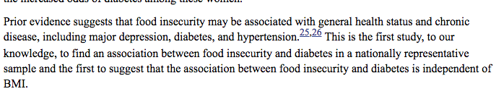
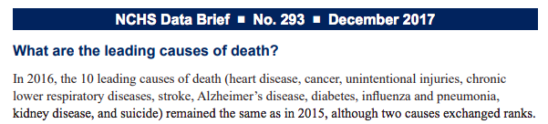
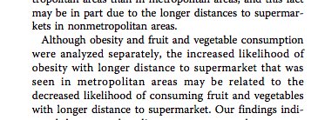


The Magnitude of the Food Scarcity
Seligman HK, Bindman AB, Vittinghoff E, Kanaya AM, Kushel MB. Food insecurity is associated with diabetes mellitus: results from the National Health Examination and Nutrition Examination Survey (NHANES) 1999-2002. Journal of General Internal Medicine. 2007;22(7):1018-1023.
Notes:
As an insurance provider, it is the role of Blue Cross Blue Shield to empower their patients through health, which should include preventative
Economic value: as an insurance company, Blue Cross Blue Shield pays less
Societal value: less individuals suffering and can allocate their energy/resources elsewhere rather than dealing with their symptoms
Empowerment is key to compliance:
Empowerment to make strategic diet and habit decisions

Slide 4

Our Mission
Improve nutritional health of individuals with chronic metabolic diseases and individuals who live in food deserts, both to mitigate and prevent disease
Increase accessibility of healthy food options to identified nutrition deserts
Create inclusive communities for peoples with different chronic diseases affecting their diet to learn, grow, and hold each other accountable for their nutritional health choices
Syda Productions. People holding hands together over table with food. Dreamstime. 2006. https://www.dreamstime.com/eating-leisure-concept-group-people-having-dinner-holding-hands-together-over-table-food-people-holding-hands-image108393822

Slide 5


The Issues & Their Solutions
Rachel Ray Meets Targeted Healthcare
Food Banks Go Mobile
A simplistic website full of easy-to-follow cooking videos tailored specifically for individuals with diet-related chronic diseases
Diabetes
Hypertension
Etc.
One-click add-to-cart option for ordering the ingredients right to your door
An online community to encourage accountability
Food trucks designed to pick up near-expired foods from grocers and food banks, screen for viability, and deliver goods to identified food deserts
Creates food accessibility to food-scarce areas
Provides food at little-to-no cost for low socioeconomic populations
Foods distributed in boxes organized to maximize nutrition
Reduces food waste

Slide 6
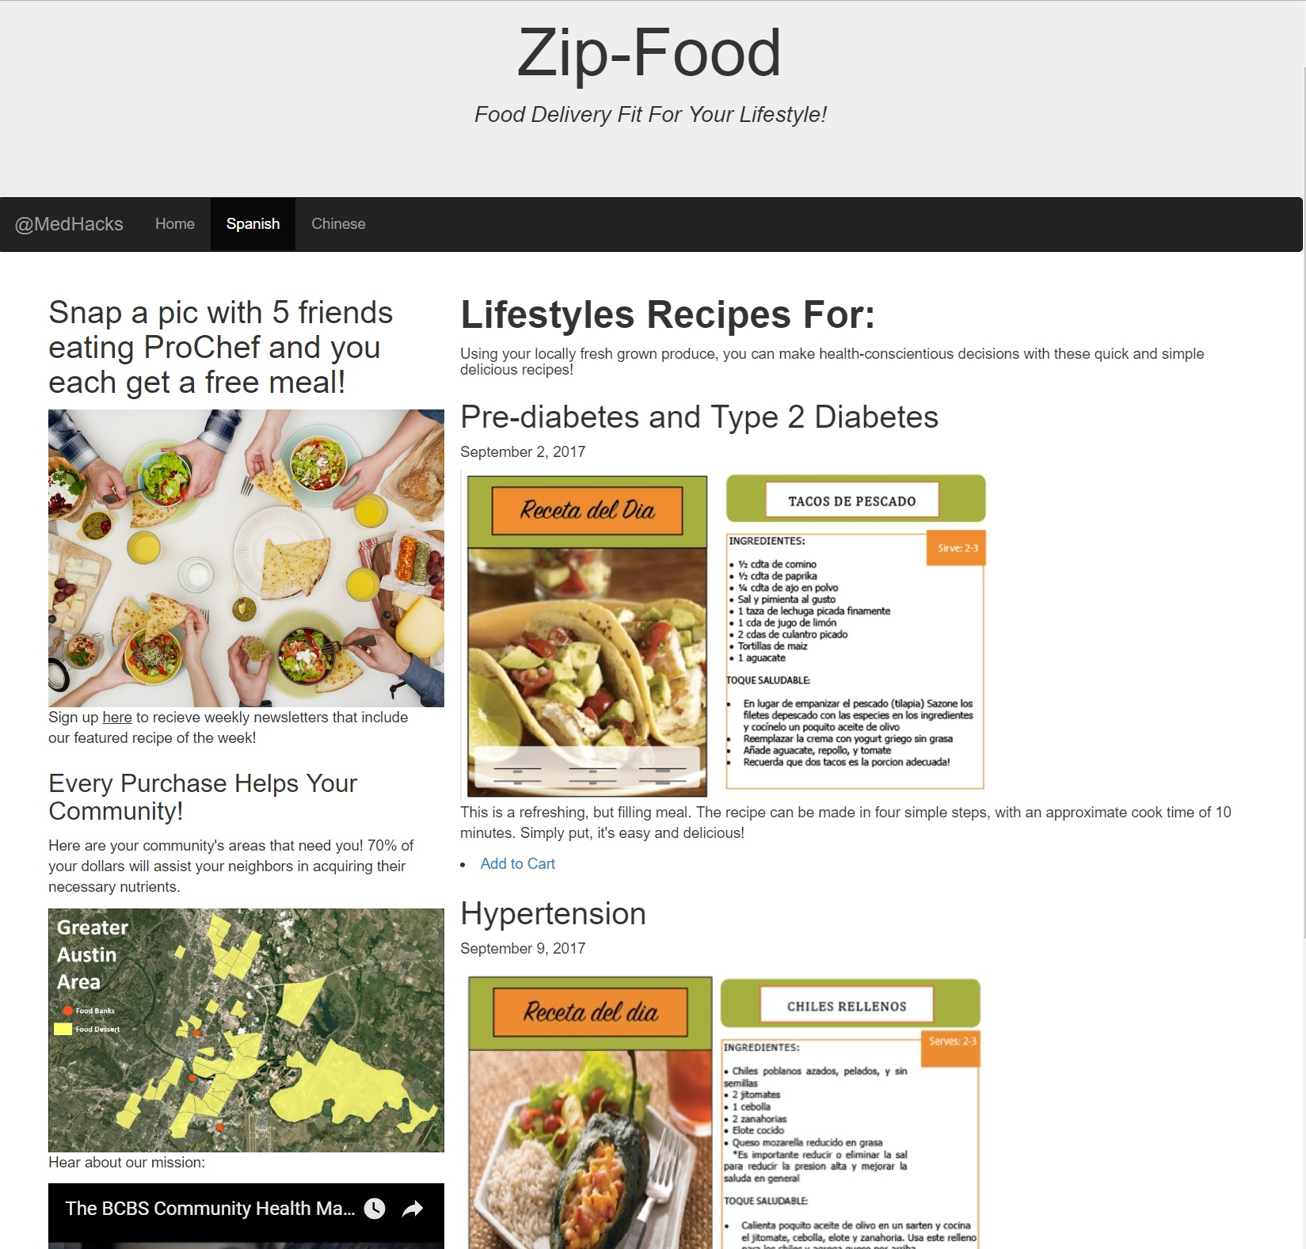
Method for Delivering Medically-Tailored Meals
Provide a platform centralizing medically-tailored recipe videos, giving users the option to purchase the correlating meal kit for home-delivery.
How this addresses barriers to healthful foods:
Price: sourcing produce from local farmers’ markets allows subsidies for those with food stamps
Accessibility: delivery service mitigates lack of transportation to grocery stores/farmers’ markets
Self-efficacy: culturally-considerate, medically-tailored cooking tutorial videos in multiple languages empower patients from diverse backgrounds with healthful options

Slide 7
The Issues & Their Solutions
Rachel Ray Meets Targeted Healthcare
Food Banks Go Mobile
A simplistic website full of easy-to-follow cooking videos tailored specifically for individuals with diet-related chronic diseases
Diabetes
Hypertension
Etc.
One-click add-to-cart option for ordering the ingredients right to your door
An online community to encourage accountability
Food trucks designed to pick up near-expired foods from grocers and food banks, screen for viability, and deliver goods to identified food deserts
Creates food accessibility to food-scarce areas
Provides food at little-to-no cost for low socioeconomic populations
Foods distributed in boxes organized to maximize nutrition
Reduces food waste

Slide 8
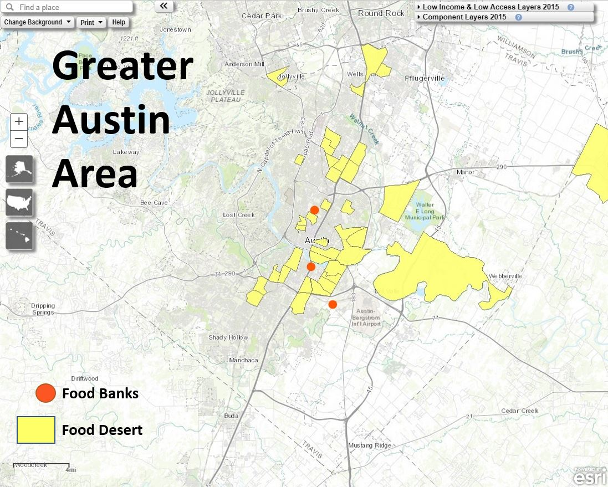
Method for Implementing Mobile Food Banks
Use excess funds from the medically-tailored meals program to collect and distribute unadulterated produce to residents living in nutritional deserts
How we create accessibility in areas of scarcity:
Local: Partner with local food banks to distribute their products in nearby nutrition desert regions
Efficient: Optimize distribution routes using USDA food desert map data to reduce travel costs
Effective: Bring produce to local neighborhoods in need by grocery truck for food insecure residents to pick-up for free following the same SOPs as the food banks
Ver Ploeg, M. , Breneman, V. United States Department of Agriculture Economic Research Service.
Go to the Atlas. (2017). Retrieved from https://www.ers.usda.gov/data-products/food-access-research-atlas/go-to-the-atlas.aspx

Slide 9
Food Delivery Fueling Food Delivery:
Our Business Model
Cost of Providing Free Food Delivery Service to Nutrition Deserts
Net Funds Generated Through Our Online, Medically-Tailored Meals Program

Slide 10
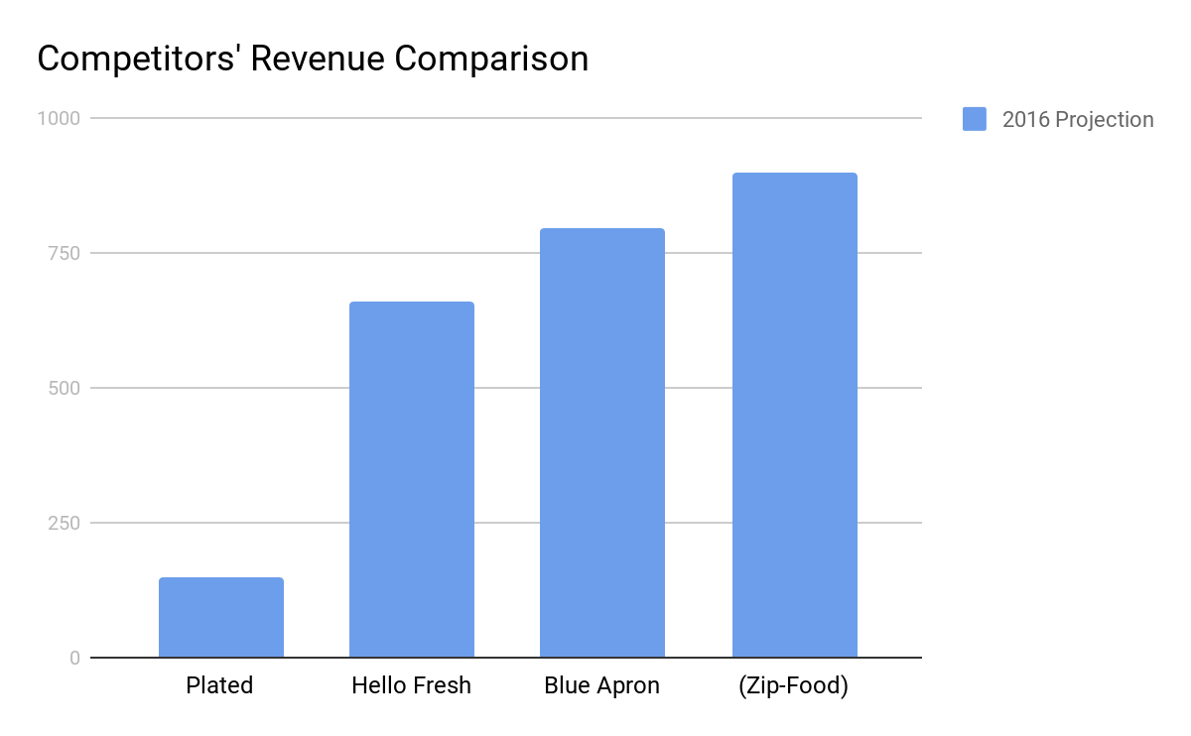
Competitors’ Profit/Revenue
2018 revenue in online food delivery $20,186M
Expected annual growth rate of 9.7% in the next 4 years
Company | 2016 | 2015 | 2014
Blue Apron | $795.4 M | $340.8 M | $77.8 M
Hello Fresh | $659.6 M | 352.9 | $80.5 M
Plated.com | $150 M | $100 M | $20 M

Slide 11

The Future
Expand nationwide using national Blue Cross Blue Shield food desert data
Provide healthcare measurement service in food trucks, gathering information on people who are mostly unreachable by traditional healthcare
The health information from the mobile food banks has high density and continuity - very valuable for chronic disease research institutes
Pongparnit, Busakorn. Smart city and internet of things, wireless communication network. Dreamstime. https://www.dreamstime.com/stock-photo-smart-city-internet-things-wireless-communication-network-abstract-image-visual-image93315266

